Slide 1
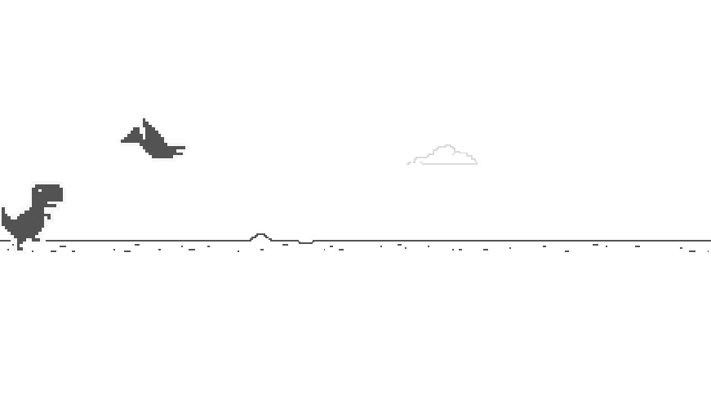
Playing Dino using NEAT
Matyáš Mattanelli

Slide 2
Outline
Dino
NEAT
Fitness function
Experiments

Slide 3
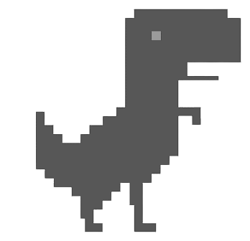
Dino
The Dinosaur Game or Chrome Dino
Browser game developed by Google in 2014
Player guides a T-Rex across a landscape avoiding obstacles
Collision with an obstacle ends the game
The goal is to survive as long as possible

Slide 4


Dino
9 distinct obstacles
2 types: Cactus, Pterosaur
Cactus
2 sizes (small and large)
3 different shapes within each size
Pterosaur
1 size
Emerges in three different altitudes within the landscape
Either static or moves slowly towards Dino
The game moves progressively faster

Slide 5
Dino
Dino is controlled using 9 possible moves
NO_MOVE
UP
UP_RIGHT
RIGHT
DOWN_RIGHT
DOWN
DOWN_LEFT
LEFT
UP_LEFT

Slide 6
Dino
The game provides information about Dino and its environment
Dino’s x and y position
All the currently existing obstacles
Their type
Their x and y position
Their height and width
Their speed (non-zero for non-static pterosaurs)
Game speed

Slide 7
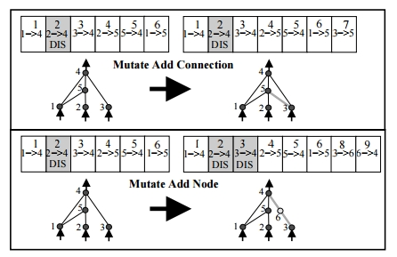
NEAT
NeuroEvolution of Augmenting Topologies
The topology of the network is evolved along with its parameters
Genomes are grouped into species with similar topologies
The fitness of genomes within one species is shared

Slide 8
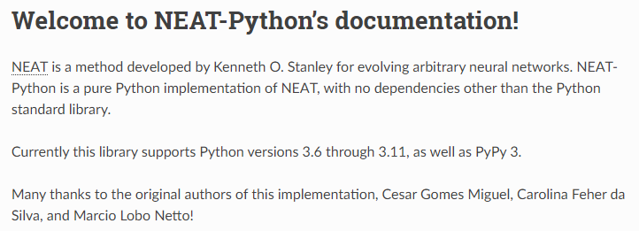
NEAT
Python implementation in the module neat-python
The specifics of the evolution are provided in a configuration file
The main challenge is to specify the fitness function

Slide 9
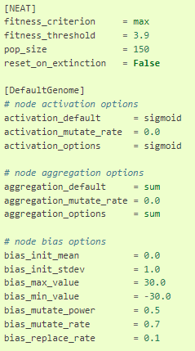
NEAT
Many available parameters
Evolution can stop after specified number of generations or upon reaching the fitness threshold
Initialization of weights and biases can be set
Their minimum and maximum values
The standard deviation of the term added during mutation
Activation function
Species: Elitism, minimum number of members of a species, stagnation
Probability of adding, deleting a node

Slide 10
Fitness function
The goal is to survive as long as possible
The longer a genome survives, the better should be its fitness
The game consists of individual ticks
During each tick, the neural networks predicts Dino’s move
The fitness is evaluated as the average score achieved from a given number of simulations
In the simple case, only a single simulation is performed

Slide 11
Starting simple
Only 3 allowed moves: NO_MOVE, UP, DOWN
Fitness function as the score from a single simulation (with a fixed seed)
3 inputs to the network
Distance to the closest obstacle
Difference between the Y of dino and top of the obstacle
Difference between the Y of dino and bottom of the obstacle
Population size: 50
Activation function: sigmoid
500 generations

Slide 12
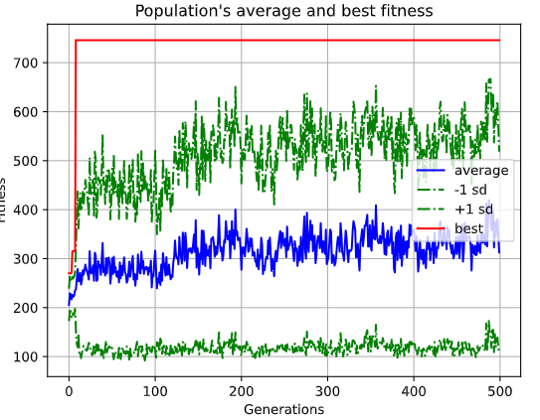
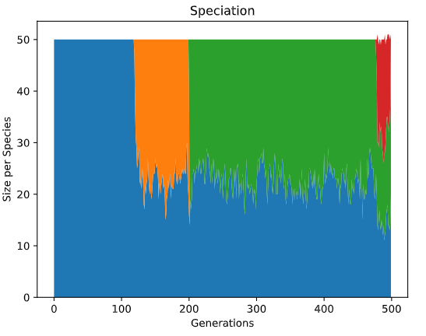
Starting simple - results

Slide 13
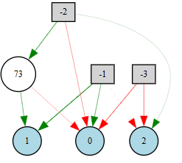
Starting simple – topology of the best genome

Slide 14

Starting simple

Slide 15
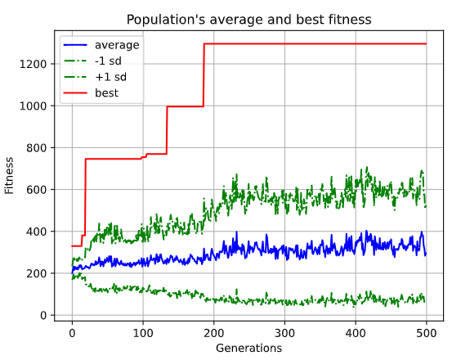
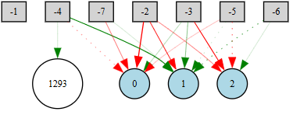
Improving
Information about more than 1 obstacle may help
The game speed appears to be important

Slide 16
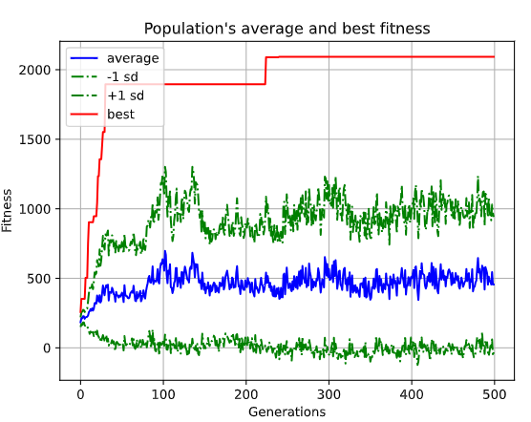
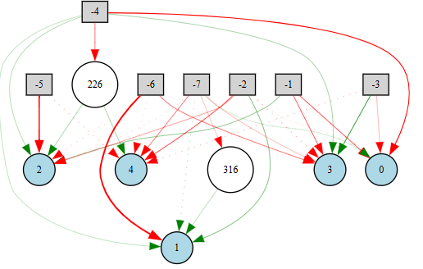
Going further
Adding 2 additional possible moves: RIGHT, LEFT

Slide 17
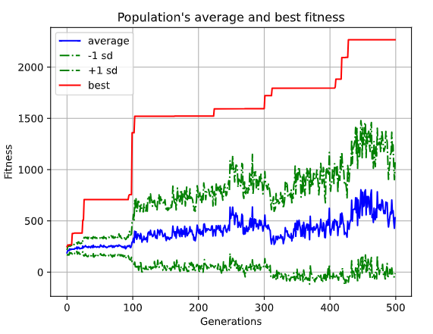
Even further
3 instead of 2 obstacles

Slide 18
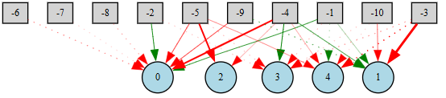
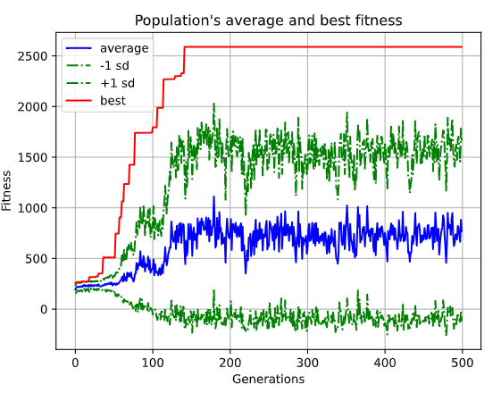
Full control
All 9 moves allowed

Slide 19
Full control

Slide 20
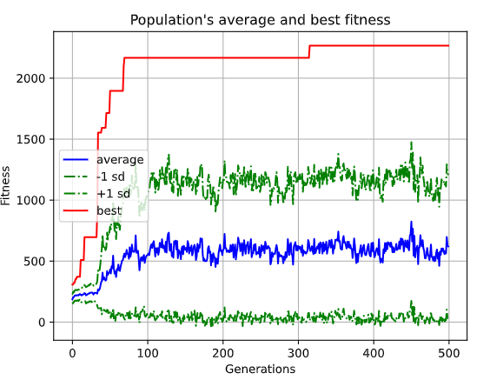
Increasing population size
Population size 150 instead of 50
Does not improve the results

Slide 21
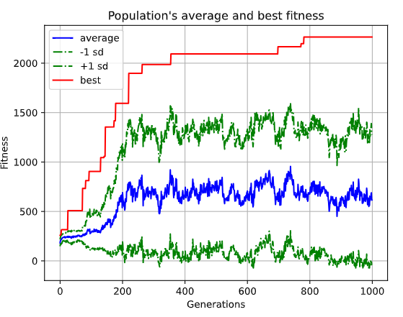
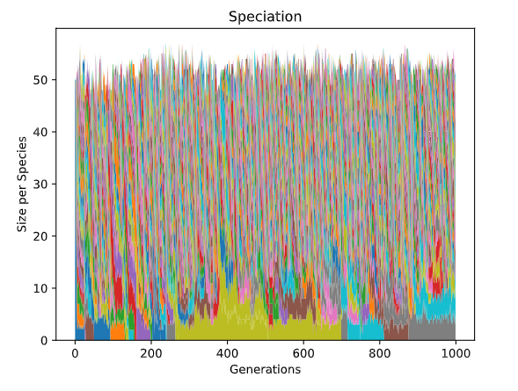
Changing genetic parameters
Increasing the standard deviation of the random number added to weights/bias during mutation
0.5 2
Results in slower convergence

Slide 22
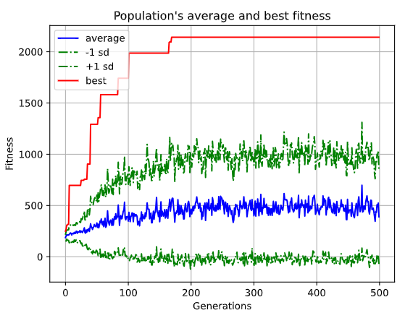
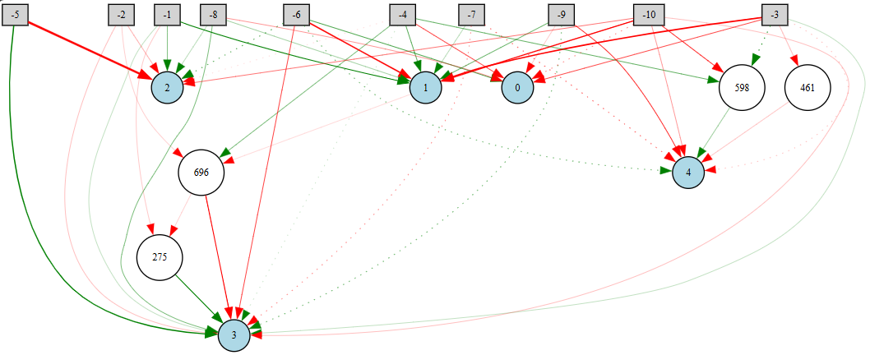
Changing the activation function
So far only sigmoid
Adding tanh to the mix and raising probability of mutating the activation function from 0 to 0.1

Slide 23
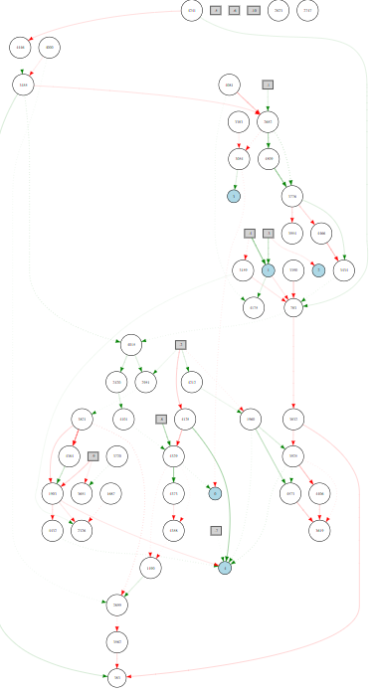
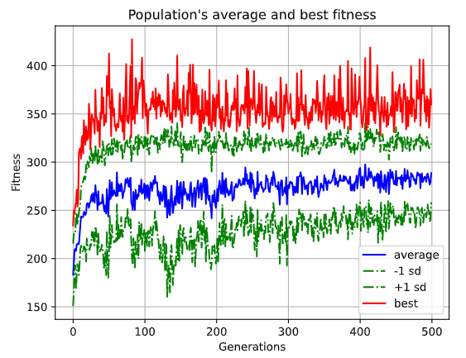
Moving to multiple simulations
Instead of a single fixed seed, the fitness is now the average of random 20 simulations

Slide 24
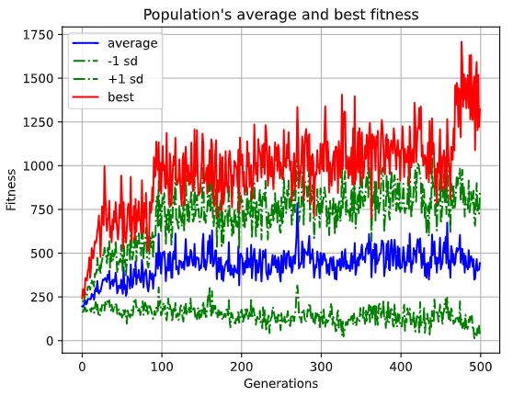
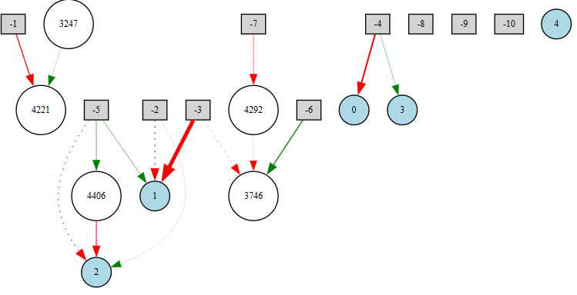
Multiple simulations
In the previous case, the simulations were random even within each generation (different for each genome)
Fixing the seed within each generation helps

Slide 25
Summary
Setup | Best score
1 obstacle, 3 inputs, 3 moves | 746
2 obstacles, 4 inputs (+game speed), 3 moves | 1 296
2 obstacles, 4 inputs, 5 moves | 2 093
3 obstacles, 4 inputs, 5 moves | 2 267
3 obstacles, 4 inputs, 9 moves | 2 589
3 obstacles, 4 inputs, 9 moves, 150 pop size | 2 267
3 obstacles, 4 inputs, 9 moves, 2 mut_size, 1000 gens | 2 265
3 obstacles, 4 inputs, 9 moves, tanh | 2142
3 obstacles, 4 inputs, 9 moves, 20 simulations | 324.05
3 obstacles, 4 inputs, 9 moves, 20 simulations (fixed within each generation) | 1324.1

Slide 26
Thank you for Your attention

